Slide 1
MSDS 6370 Statistical Sampling Designing a stratified sampling plan
Presented by
Ekaterina Pirogova
Hari Narayan Sanadhya

Slide 2
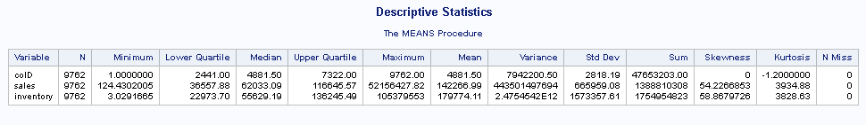
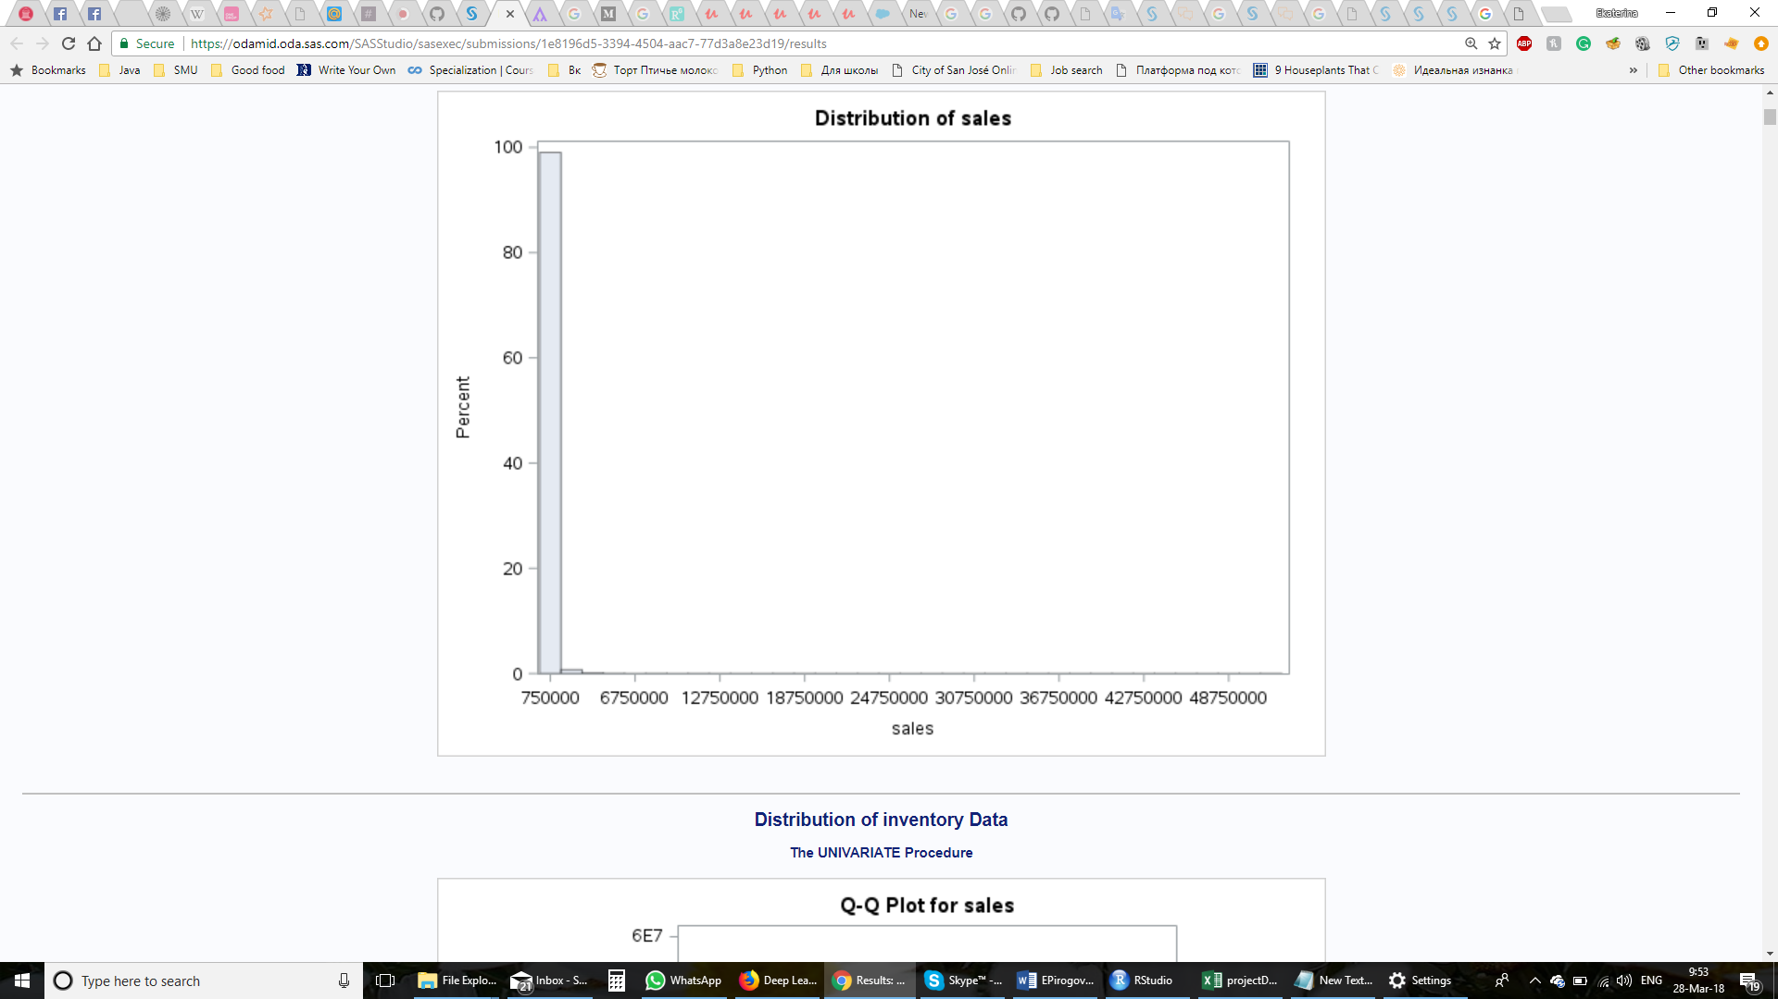
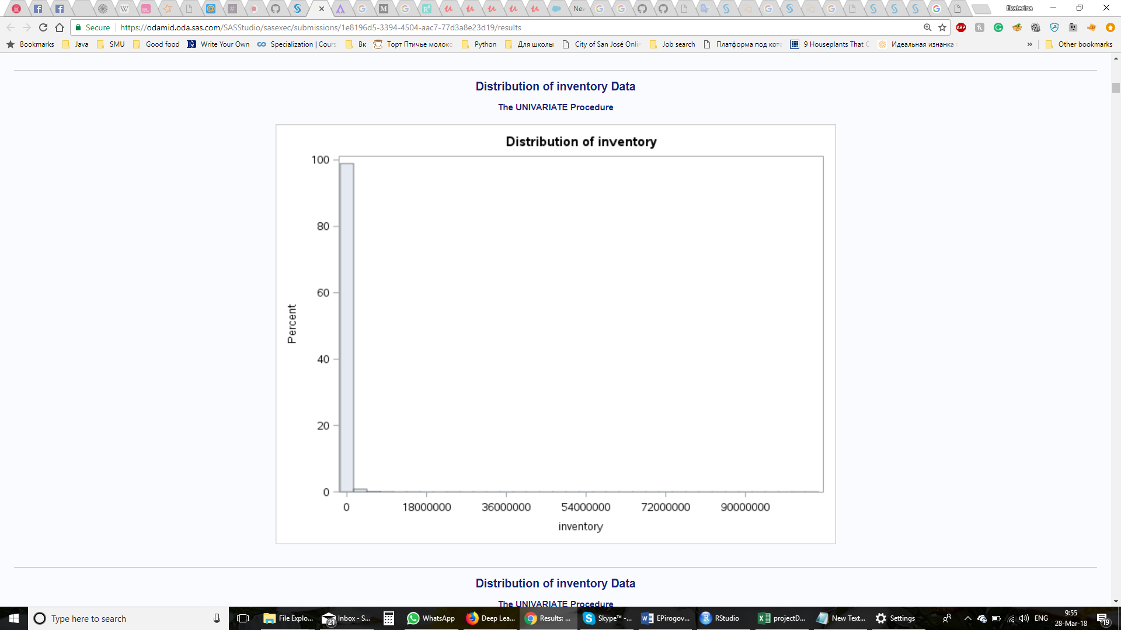
Descriptive Statistics

Slide 3
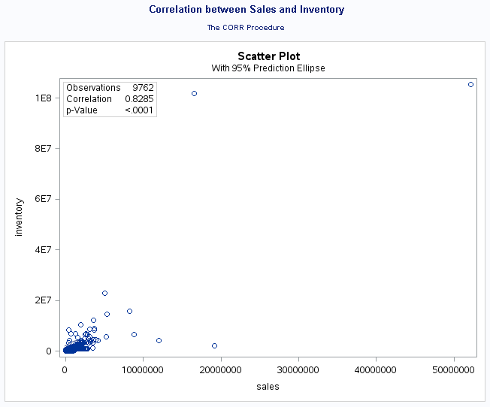
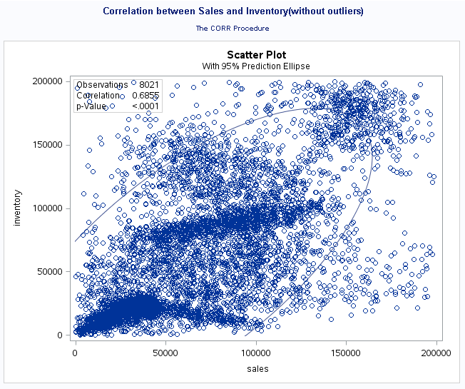
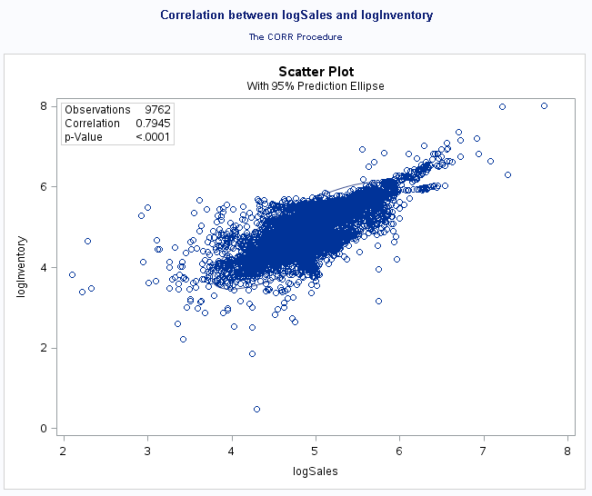
Descriptive Statistices cont … Plots showing Correlation between Sales and Inventory

Slide 4
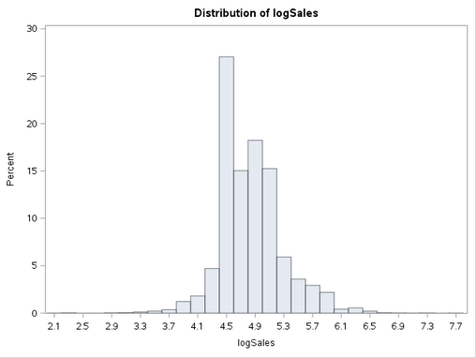
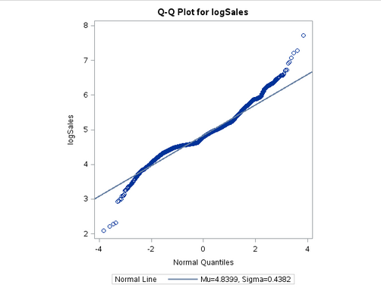
Estimation of Sales
6 Methods used
Non Stratified Simple Random Sampling
Non Stratified Systematic Random Sampling
Stratified using LogSales with Neyman Allocation and Simple Random Sampling
Stratified using LogSales with Neyman Allocation and Systematic Random Sampling
Stratified using Cumulative Method with Neyman Allocation and Simple Random Sampling
Stratified using Cumulative Method with Neyman Allocation and Systematic Random Sampling

Slide 5
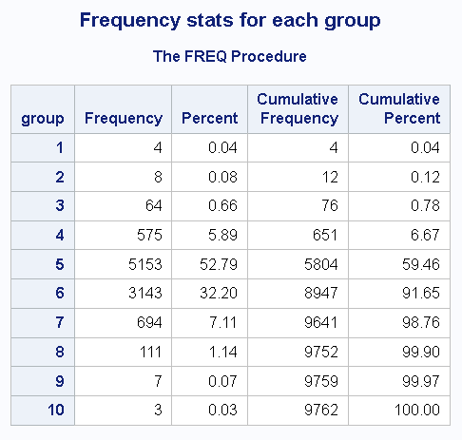
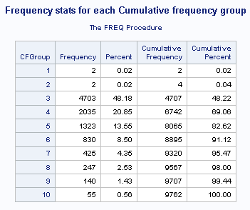
Frequency stats for the strata formed

Slide 6
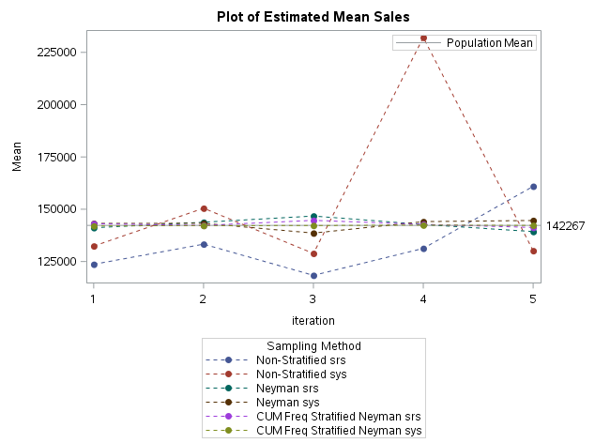
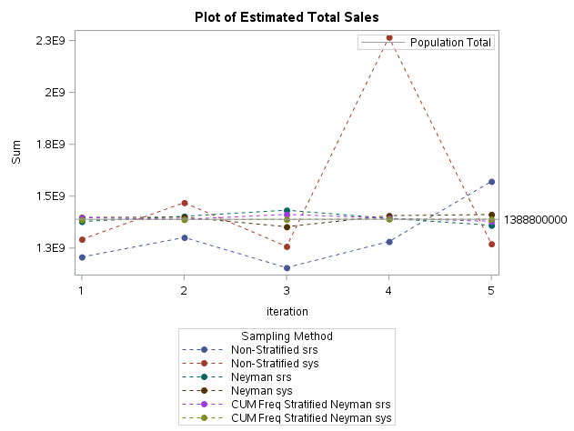
Estimated Mean and Total Sales obtained in each iteration

Slide 7
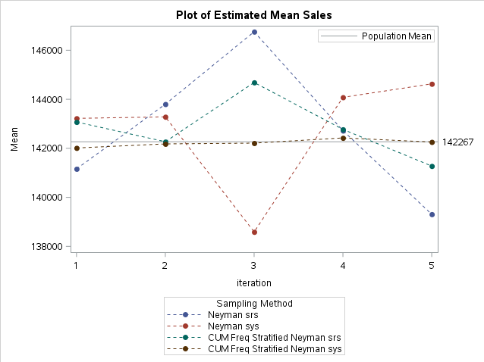
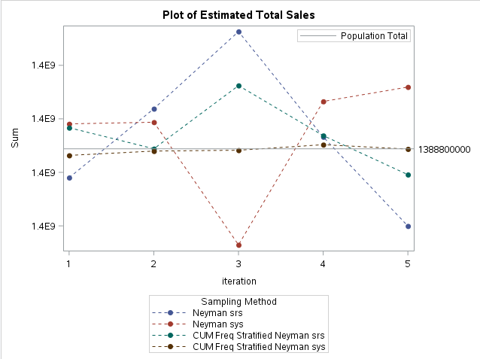
Estimated Mean and Total Sales obtained in each iteration without Non Stratified Sampling

Slide 8
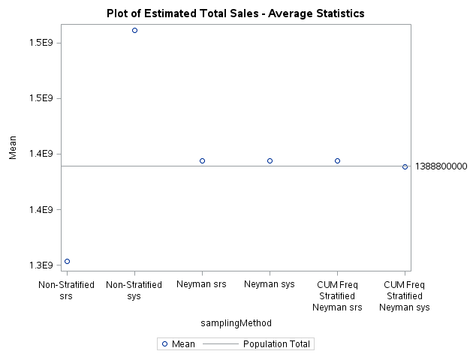
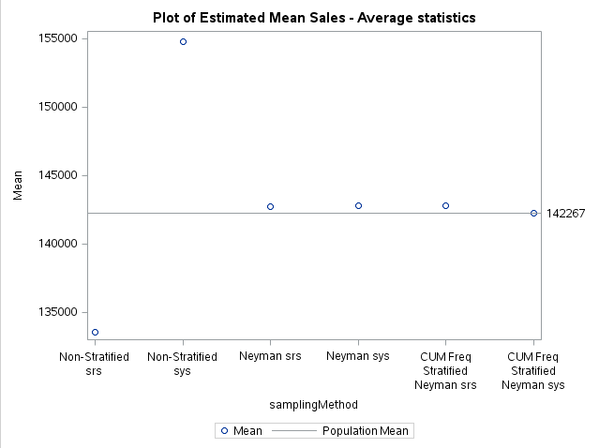
Average Estimated Mean and Total Sales obtained for each algorithm

Slide 9
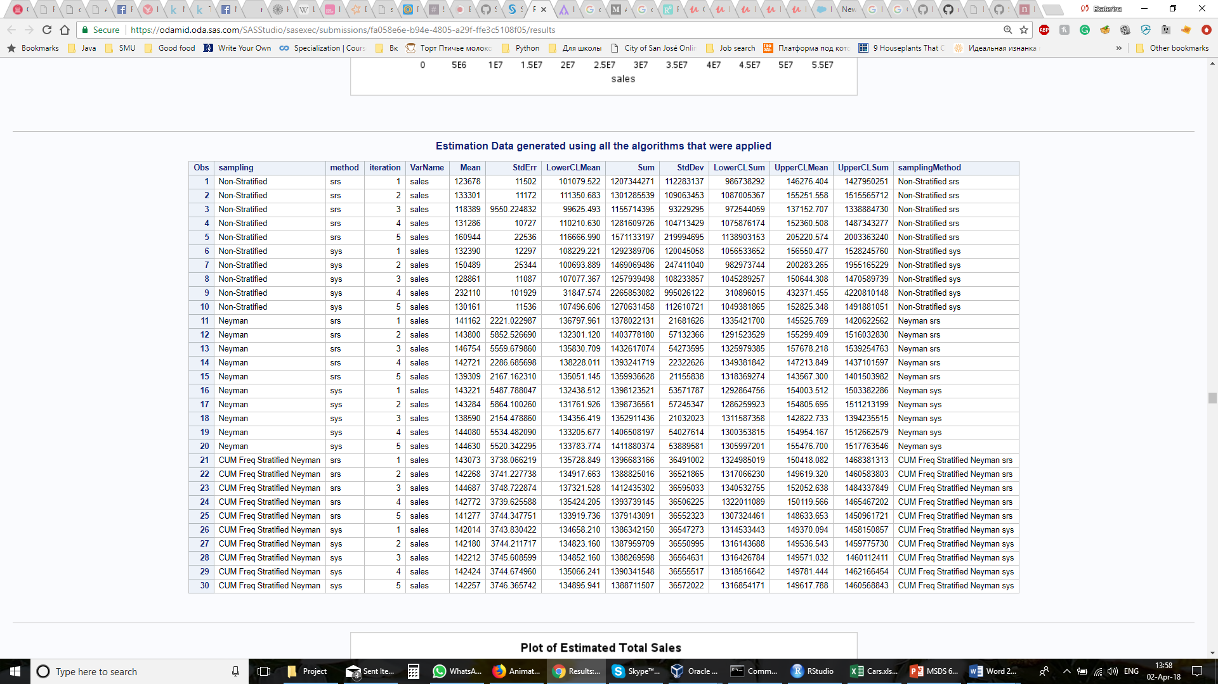

Slide 10
Estimation of inventory
Non Stratified Simple Random Sampling
Non Stratified Systematic Random Sampling
Stratified using LH method with Neyman Allocation and Simple Random Sampling
Stratified using LH method with Neyman Allocation and Systematic Random Sampling
Stratified using equal WhSh Method with Neyman Allocation and Simple Random Sampling
Stratified using equal WhSh with Neyman Allocation and Systematic Random Sampling

Slide 11
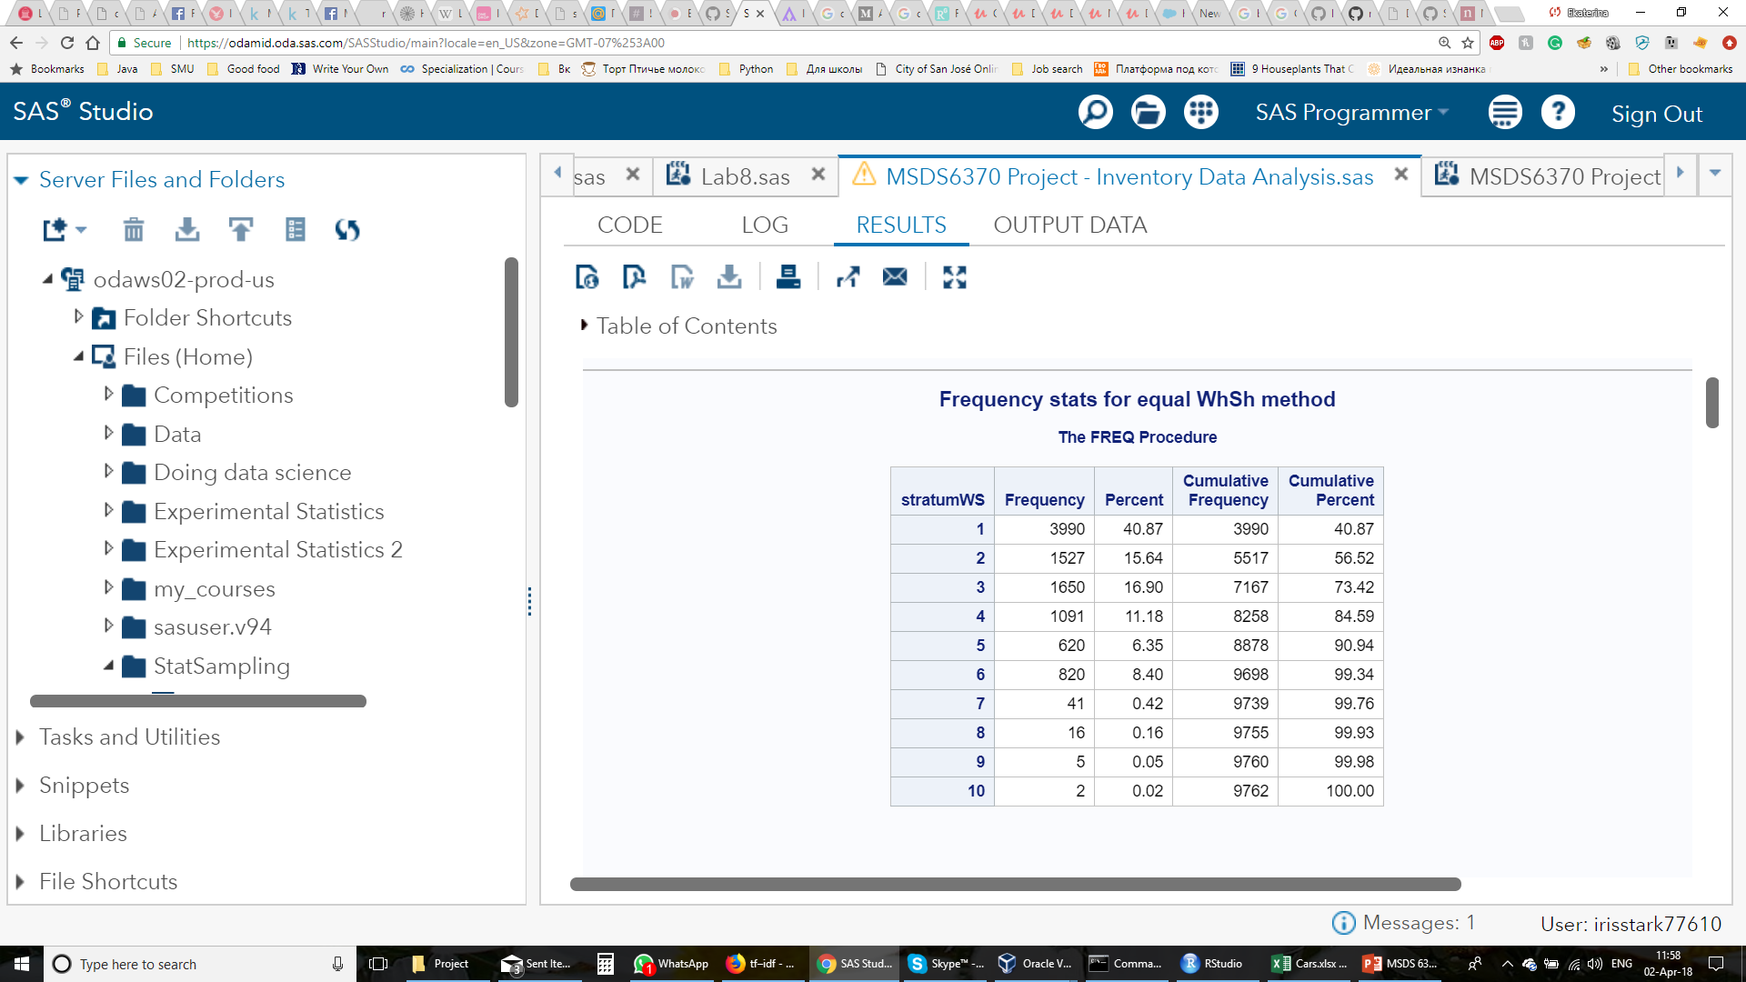
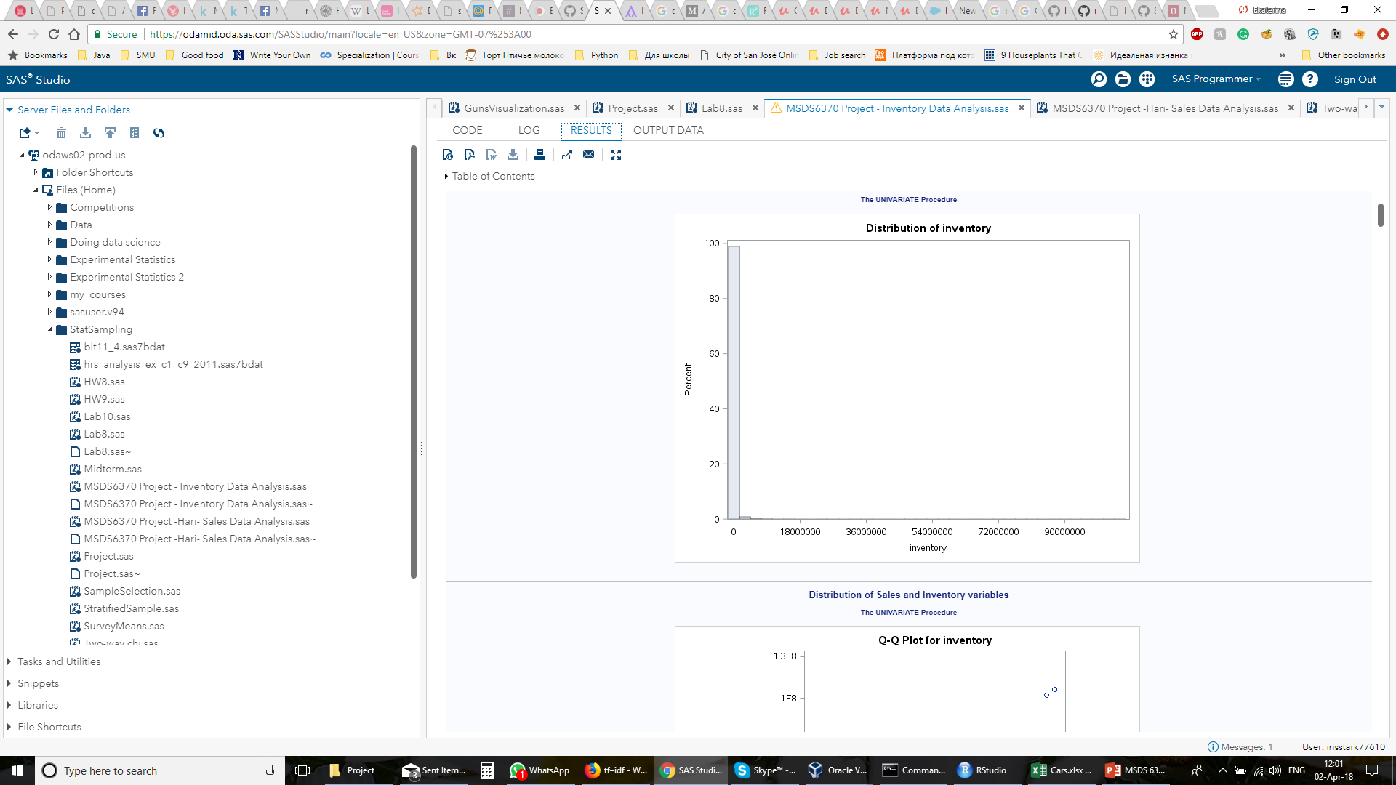
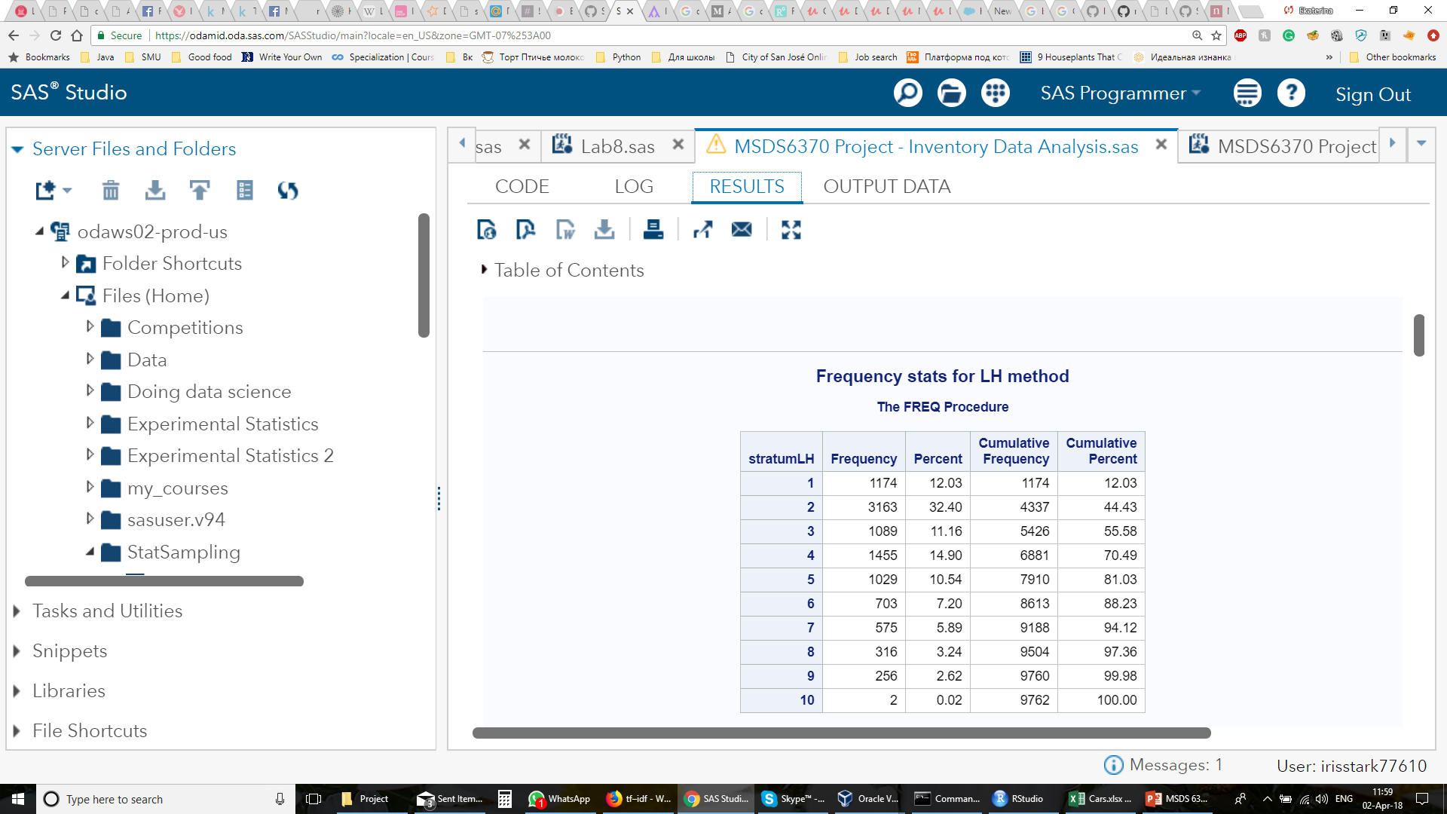
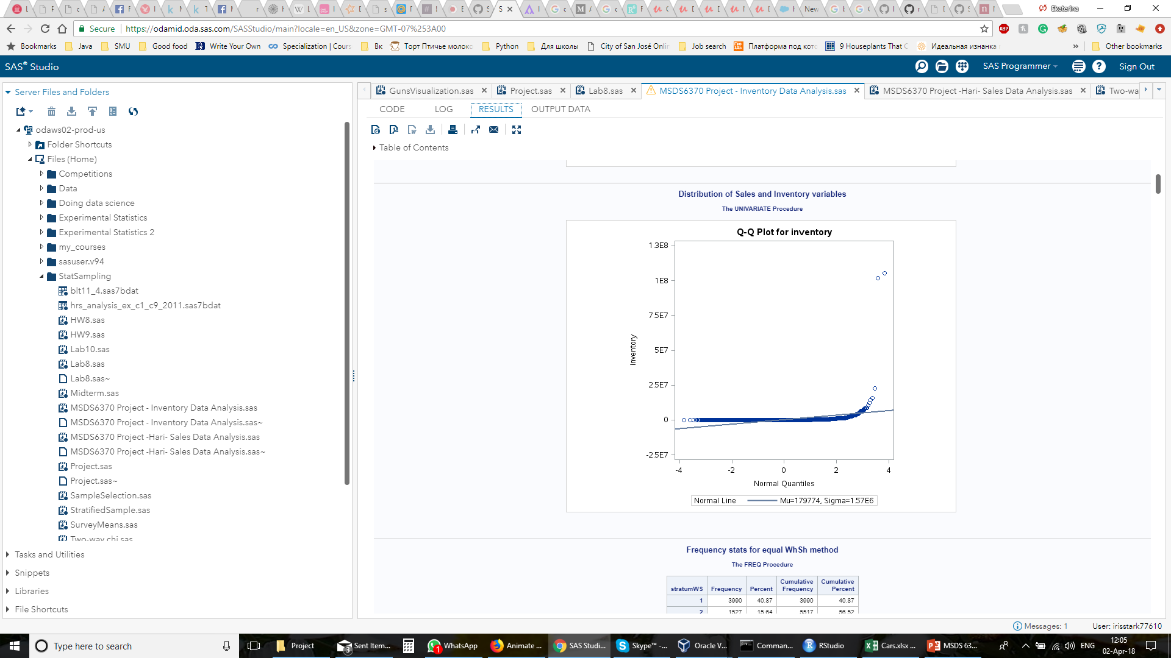
Frequency stats for the strata formed

Slide 12
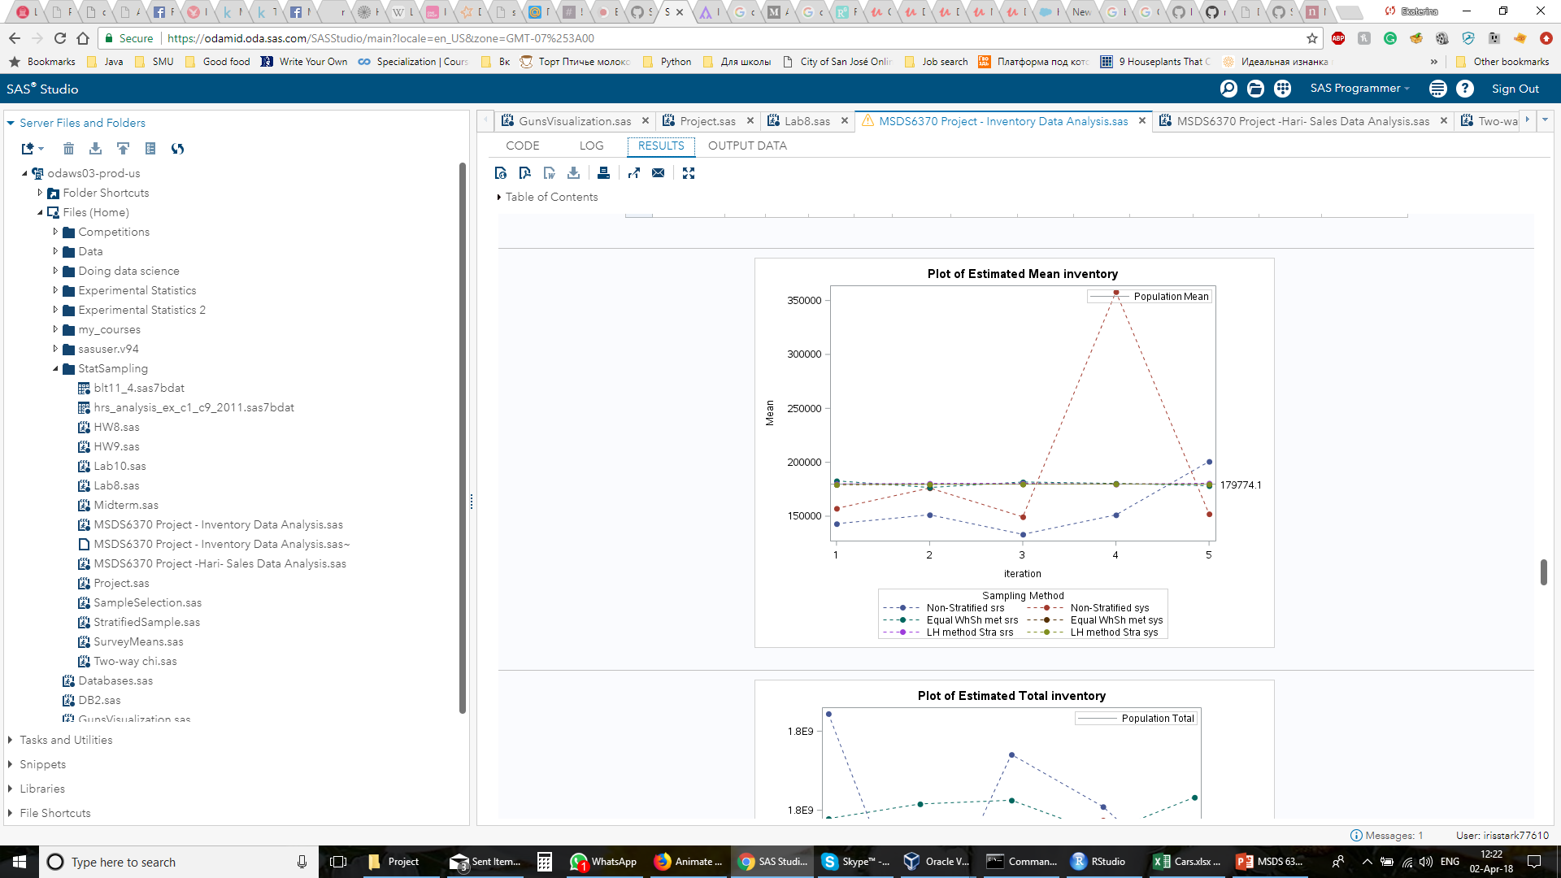
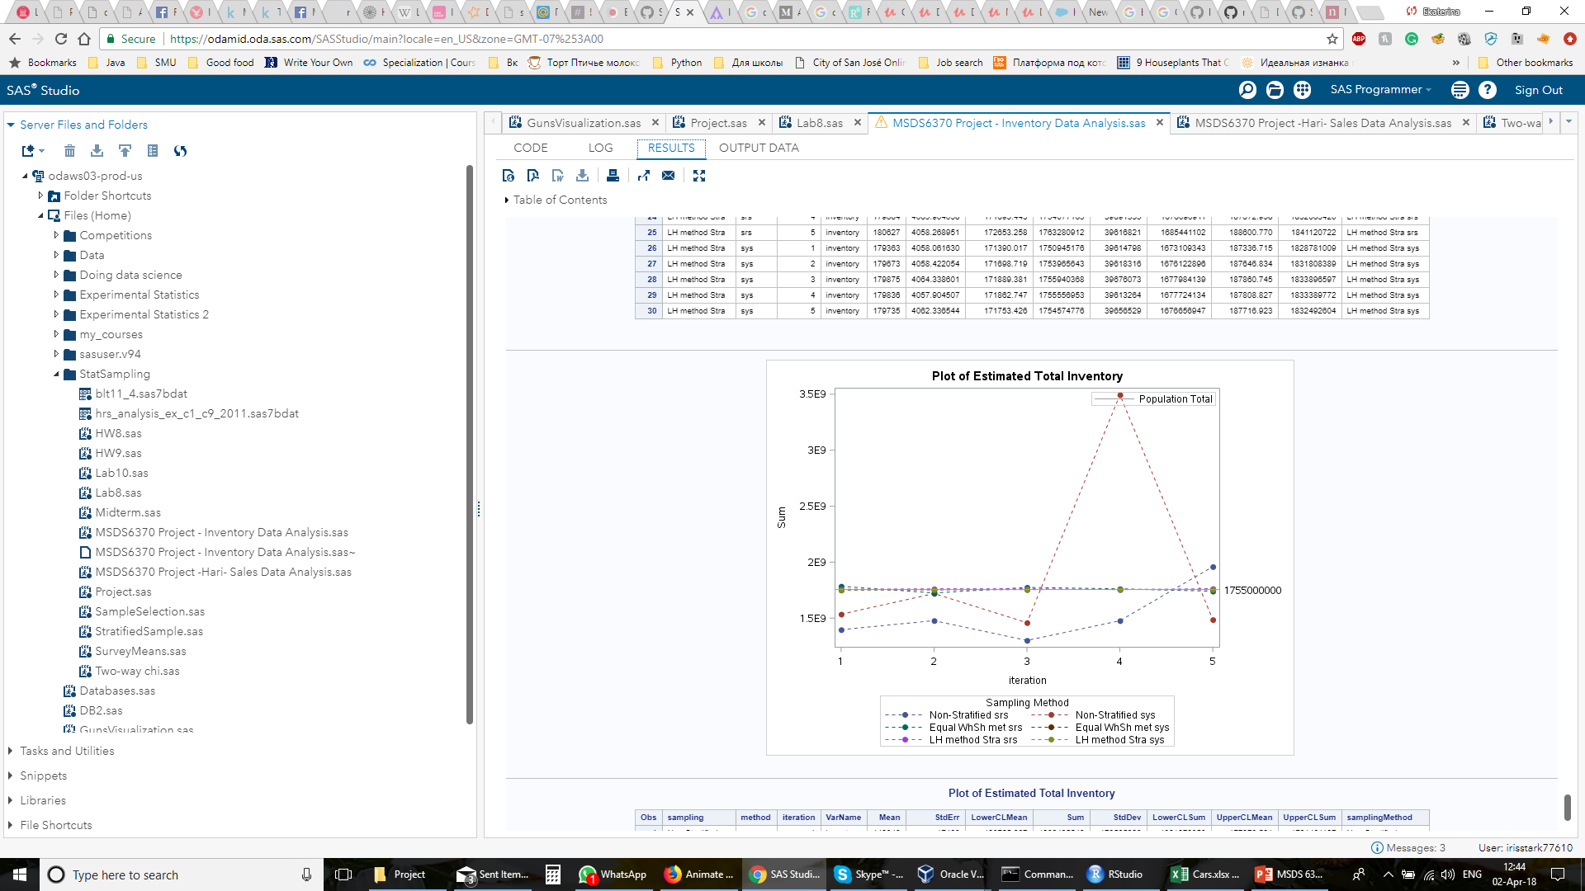
Estimated Mean and Total Inventory obtained in each iteration

Slide 13
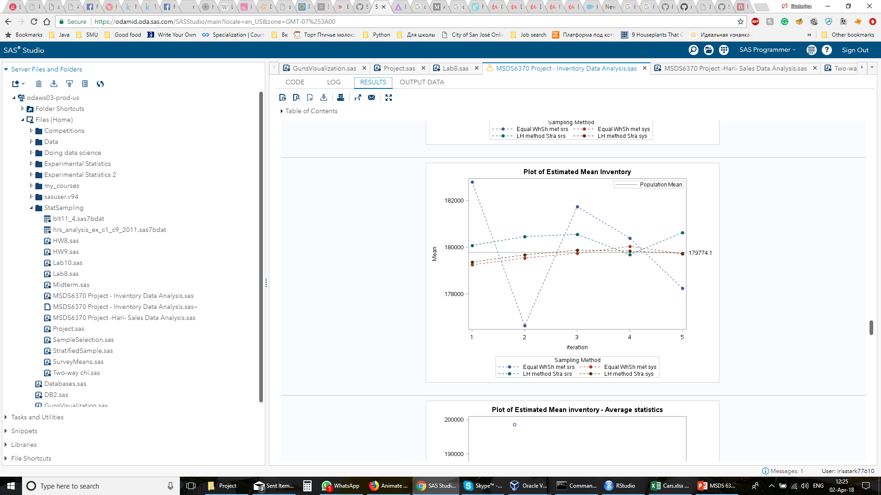
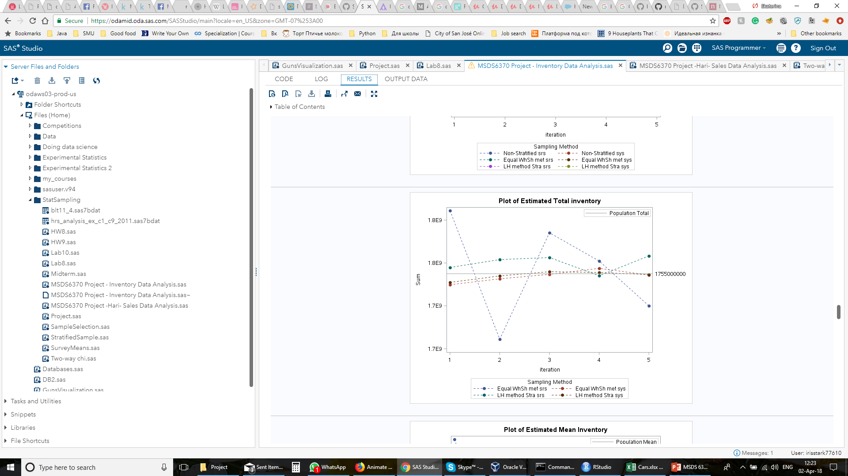
Estimated Mean and Total Inventory obtained in each iteration without Non Stratified Sampling

Slide 14
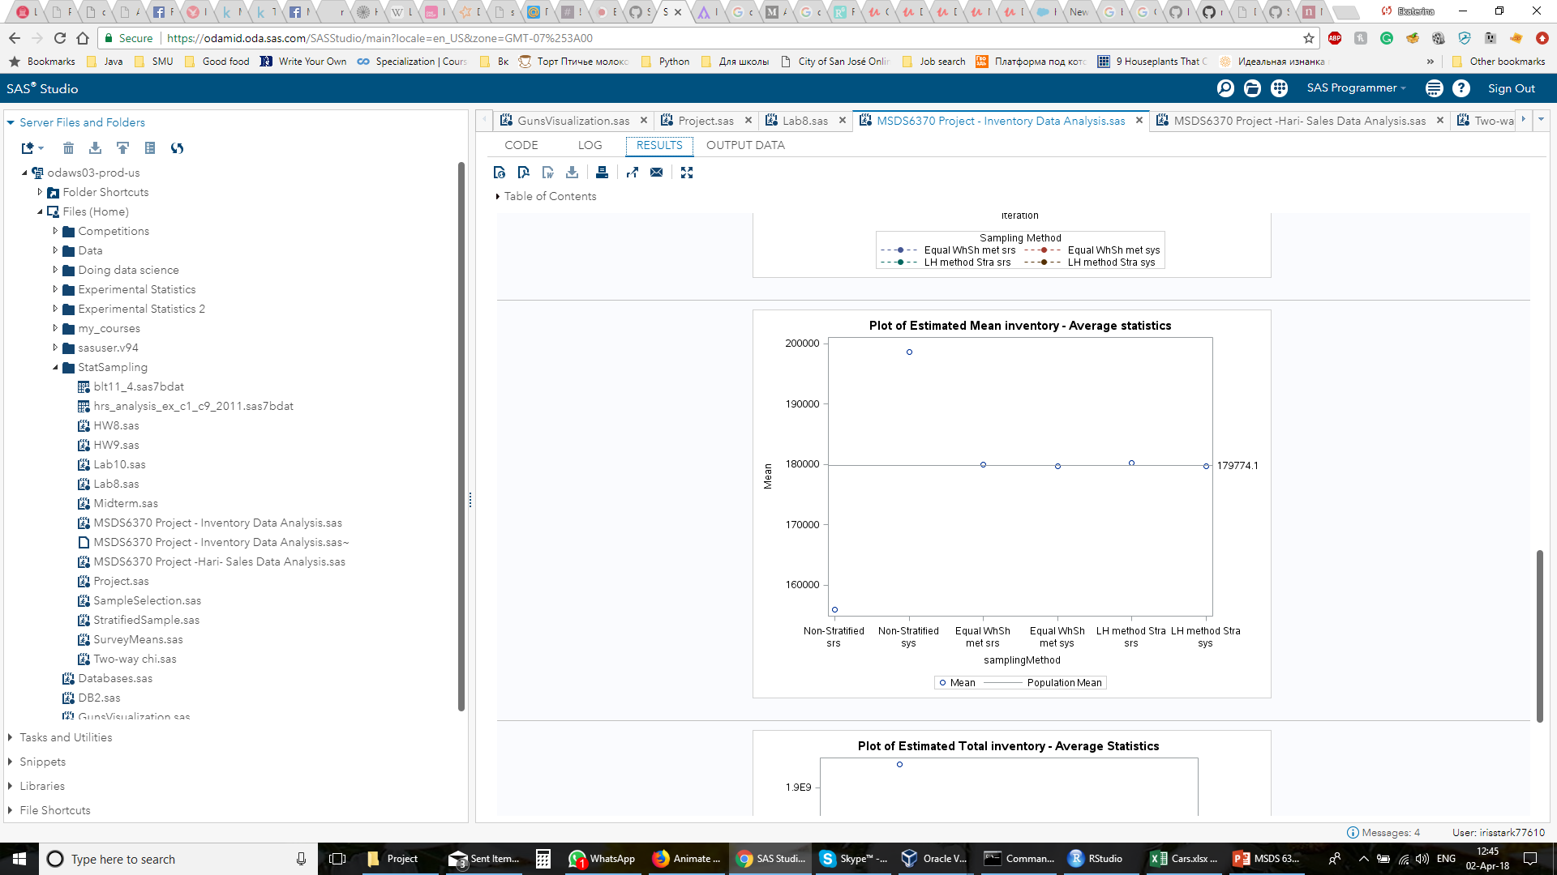
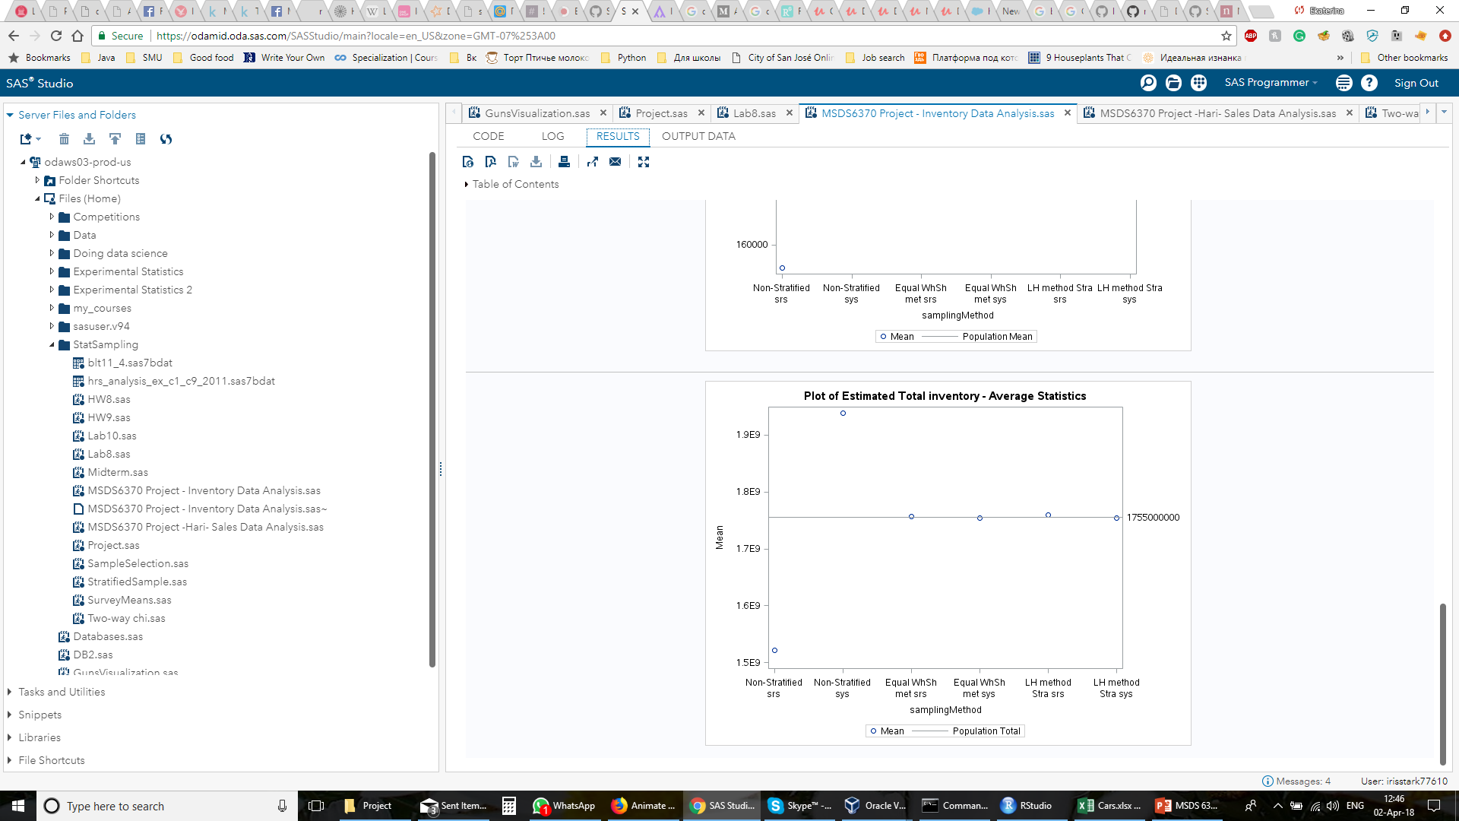
Average Estimated Mean and Total Inventory obtained for each algorithm

Slide 15
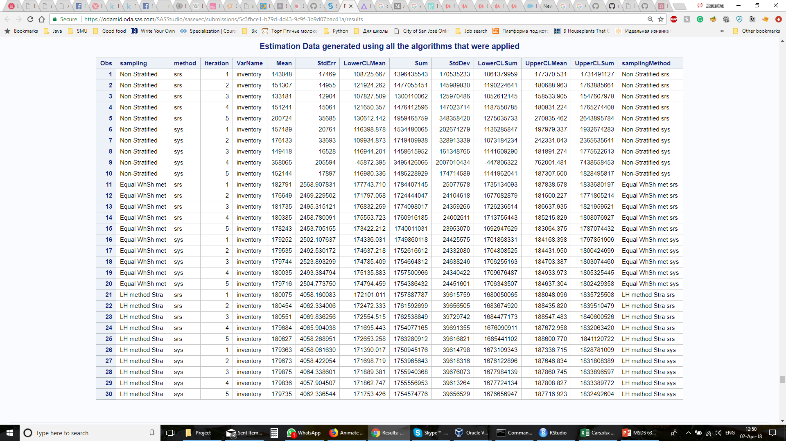

Slide 16
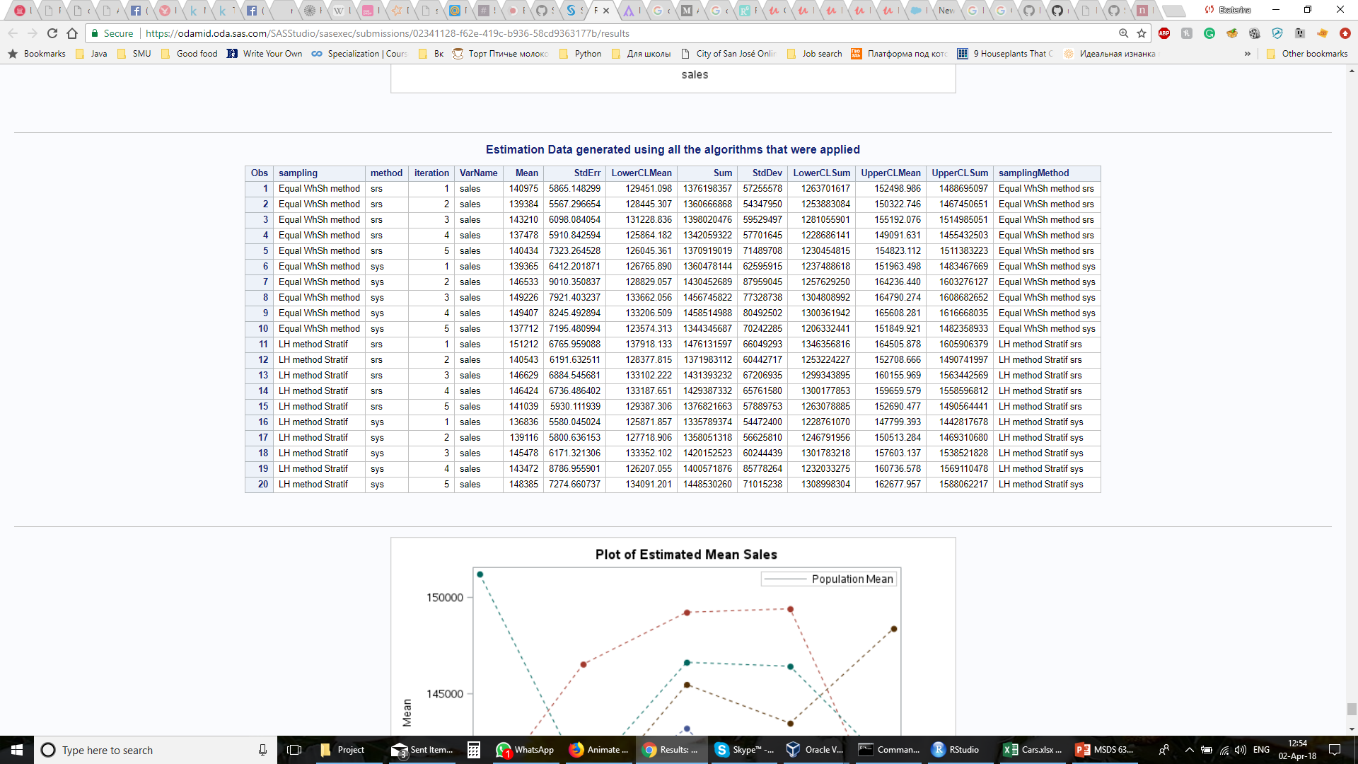
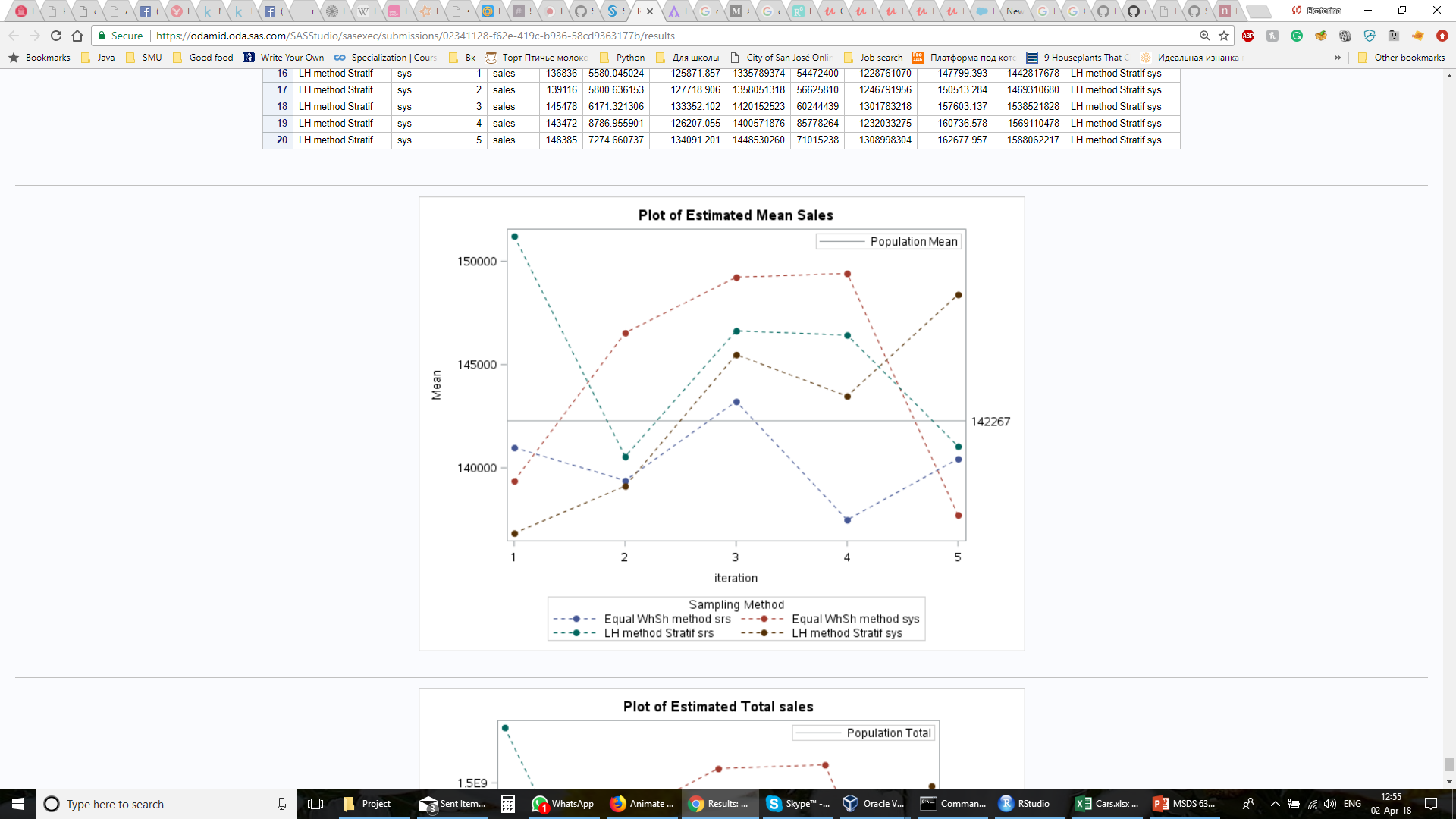
Stratification on inventory for sales

Slide 17
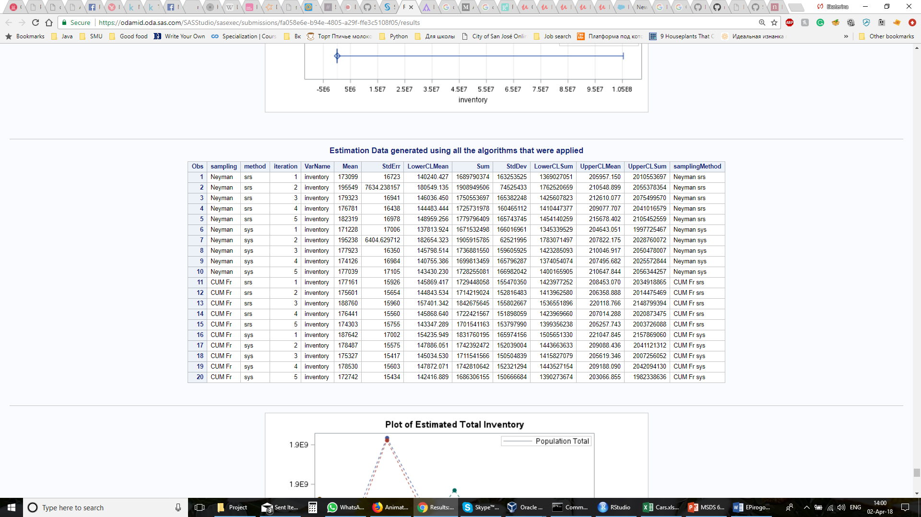
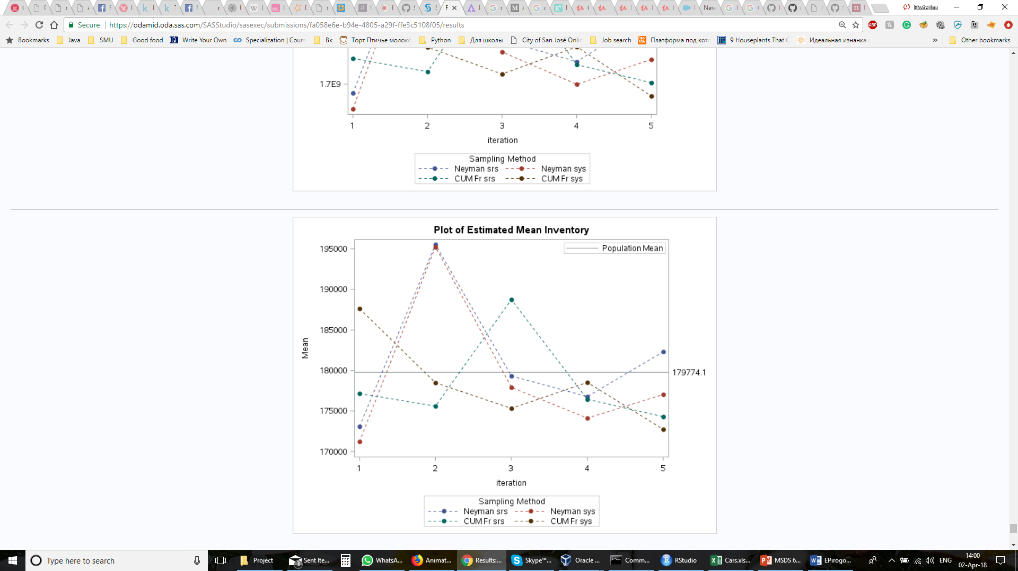
Stratification on sales for inventory

Slide 18

Questions

Slide 19
Sample SAS Code
%macro srs_sys_sampling_neyman_cf(srs_sys);
%local temp;
%do i=1 %to 5;
/* Estimation of Sales using SRS */
proc surveyselect data=work.industrydata sampsize=500 out=SRSSAMPLE method= &srs_sys seed=&&seed&i;
%let title = Neyman Sampling using &srs_sys - Stratified using Cumulative Frequency;
strata CFGroup/ alloc=neyman var=(&varSalesStrata) allocmin=2;
title &title;
run;
proc surveymeans data=SRSSAMPLE total=&recordCount mean stderr clm sum std clsum;
var sales;
strata CFGroup;
weight samplingWeight;
ods output Statistics = surveyMeansoutput;
run;
%let temp=%TSLIT(&srs_sys);
%put &temp;
%if %sysfunc(exist(WORK.projectOutputSummary))
%then %do;
proc sql noprint;
insert into work.projectOutputSummary
select 'CUM Freq Stratified Neyman' as sampling, &temp as method, &i as iteration, outtable.* from surveyMeansoutput as outtable;
run;
%end;
%else %do;
proc sql noprint;
create table work.projectOutputSummary as
select 'CUM Freq Stratified Neyman' as sampling, &temp as method, &i as iteration, outtable.* from surveyMeansoutput as outtable;
run;
%end;
%end;
%mend; %srs_sys_sampling_neyman_cf(srs);
%srs_sys_sampling_neyman_cf(sys);

